Slide 1
Git, PyCharm & Azure DevOps
From Version Control Basics to Seamless Team Collaboration
Notes:
https://www.protectedtext.com/git-pycharm-ado
Password: ergo1234

Slide 2

Wolfgang Moser Solution Architect
7 years at Woodmark
Studied Physics
Expertise in:
Software Development
Data Engineering
Cloud Architectures

Slide 3
Agenda
Day 1
Day 2
Introduction to Git
Git Basics (2 Labs)
Branching (1 Lab)
Merge
Rebase
Best Practices
Pre-Commit Hooks
Branching Strategies
Git Integration in PyCharm (1 Lab)
Azure DevOps (1 Lab)
Version Control & Collaboration
Work Item Tracking
CI/CD Pipelines

Slide 4
Introduction to Git

Slide 5
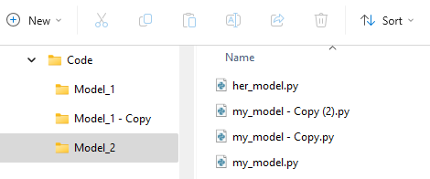
The Challenge without Version Control
Introduction to Git
Team of engineers working on the same project
Challenges:
Multiple copies of the same codebase
Difficulty in tracking changes: Who made what change, and why?
Risk of losing critical work by deletion or overwriting
Merging individual contributions manually (emailing files, copy-pasting code)

Slide 6




Version Control before Git: The CMS Era
Introduction to Git
Early Centralized Version Control Systems (CVCS): CVS, RCS, SVN (Subversion), and Perforce
Address version control problems:
Central repository: Files stored in a single server that everyone could access.
Basic change tracking: Developers could check out code, make changes, and commit to the central server.
Locking mechanism: Prevented multiple people from editing the same file simultaneously.
Some problems persisted:
Single point of failure: If the central server went down, no one could access or commit changes.
Slow performance: Large projects (like the Linux Kernel) had slow checkouts, especially with remote servers.
Poor branching and merging: Branching was slow and merging was error-prone, leading to broken codebases.
No offline work: Developers needed a constant connection to the server to work efficiently.
Notes:
CVS: Concurrent Versions System
RCS: Revision Control System

Slide 7


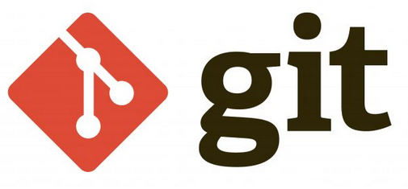
Addressing Version Control Challenges with Git
Introduction to Git
In 2005, Linus Torvalds developed Git to improve version control for the Linux Kernel.
Key Innovations:
Distributed Version Control Every developer has a complete local copy of the repository.
Efficient Branching and Merging Quick and lightweight branching with advanced merging algorithms.
Performance Fast operations for large projects and efficient handling of repositories.
Data Integrity Uses SHA-1 hashing to ensure data integrity and detect corruption.
“I'm an egoistical bastard, so I name all my projects after myself. First Linux, now git.”
Notes:
‘git‘ is British slang meaning ‘a rotten person‘.

Slide 8
How Traditional VCS Work
Introduction to Git
Checkins Over Time
Version 1
Version 2
Version 3
Version 4
Version 5
File A
Δ1
Δ2
File B
Δ1
Δ2
File C
Δ1
Δ2
Δ3
Storing data as changes to a base version of each file

Slide 9
How Git Works
Introduction to Git
Checkins Over Time
Version 1
Version 2
Version 3
Version 4
Version 5
File A
A1
A1
A2
A2
File B
B
B
B1
B2
File C
C1
C2
C2
C3
Storing data as snapshots of the project over time

Slide 10
The .git Folder
Introduction to Git
.git
├── config
├── HEAD
├── hooks
│ └── prepare-commit-msg.msample
├── objects
│ ├── info
│ └── pack
└── refs
├── heads
└── tags
⟶ a text file that contains your git configuration for the current repository
⟶ contains the current head of the repository, e.g. refs/heads/main
⟶ contain any scripts that can be run before/after git does anything
⟶ contains the git objects (the data about the files, commits etc. in your repository)
⟶ stores references (pointers). refs/heads for branches and refs/tags for tags
Notes:
https://blog.meain.io/2023/what-is-in-dot-git/

Slide 11
Git Basics

Slide 12
The Three File States
Git Basics
Git has three main states for files:
Modified: you have changed the file but have not committed it yet
Staged: you have marked a modified file in its current version to go into your next commit snapshot
Committed: means that the data is safely stored in your local database
Working Directory
Staging
Area
.git Directory (Repository)
Checkout the Project
Stage Changes
Commit

Slide 13
The Git Repository
Git Basics
Initializing a Repository in an Existing Directory
Cloning an Existing Repository
$ cd /home/user/my_project
$ git init
Creates a new subdirectory named .git that contains a Git repository skeleton.
At this point, nothing in your project is tracked yet.
$ git clone https://github.com/git/git.git
Git receives a full copy of nearly all data that the server has.
git clone supports many protocols (HTTPS, SSH, etc.)

Slide 14
Key Commands for File Status Modification
Git Basics
git status: Shows the state of the working directory and staging area.
git add <file>: Moves changes to the staging area.
git commit: Records a snapshot of the staged changes.
git diff: Shows changes between the working directory and the staging area or between commits.
git diff --staged: Shows changes between staged files and the last commit.
git rm <file>: Removes a file from the working directory and staging area.
git mv <old-file> <new-file>: Moves or renames a file.
Untracked
Unmodified
Modified
Staged
Add the File
Edit the File
Stage the File
Remove the File
Commit

Slide 15
Commits and History
Git Basics
git commit
git log
git commit -m "Initial commit" Creates a new commit with a message "Initial commit."
git commit -a -m "Update readme file" Stages all modified files and commits them with the message "Updated readme file."
git commit --amend -m "Updated readme and added new section" Edits the previous commit to include additional changes with a new message.
git commit --no-edit --amend Updates the last commit without changing the commit message.
git log Shows a list of all commits in the repository.
commit 332bbb43dd615515985a5b9 (HEAD -> main) Author: Wolfgang Moser wolfgang.moser@woodmark.de Date: Tue Oct 1 11:35:20 2024 +0200
Initial commit
git log --oneline Displays a concise one-line version of the log.
5e30cf7 (HEAD -> main) Update readme file 332bbb4 Initial commit
git log –p Shows the commit history along with the diff for each commit.

Slide 16
Ignore, Reset, Unmodify
Git Basics
git ignore <pattern> Writes the pattern into the .gitignore file which specifies files and directories to be ignored by Git.
# Ignore all .log files *.log
git reset --soft <commit> Resets the commit history but keeps changes staged. Example: git reset --soft HEAD~1
git reset --hard <commit> Resets the commit history, working directory, and staging area (dangerous – undoes all changes).
Notes:
.gitignore: Ignore build artifacts, temporary files, or sensitive information that shouldn't be committed.

Slide 17
Lab #1
Git Basics
Follow the steps on https://gitimmersion.com/
Finish:
Labs 3-10
Labs 14-15 (git hist ~= git log –-oneline)
Labs 19-20
Bonus: Lab 22

Slide 18
Working with Remotes
Git Basics
For collaboration, we need remote repositories
Remote respositories are project versions that are hosted online (several are possible!)
Collaboration happens through pushing and pulling changes
$ git remote –v
origin git@github.com:git/git.git (fetch) origin git@github.com:git/git.git (push)
$ git remote add kernel.org \ git://git.kernel.org/pub/scm/git/git.git
$ git remote –v
origin git@github.com:git/git.git (fetch) origin git@github.com:git/git.git (push) kernel.org git://git.kernel.org/pub/scm/git/git.git (fetch) kernel.org git://git.kernel.org/pub/scm/git/git.git (push)
$ git remote show origin
* remote origin Fetch URL: git@github.com:git/git.git Push URL: git@github.com:git/git.git HEAD branch: main Remote branches: main tracked Local branches configured for 'git pull’: main merges with remote main Local refs configured for 'git push’: main pushes to main (up to date)
Notes:
.gitignore: Ignore build artifacts, temporary files, or sensitive information that shouldn't be committed.

Slide 19
Fetch, Pull & Push
Git Basics
To fetch all the data from a remote that isn’t available locally yet:
$ git fetch [<remote>]
Only downloads the data to your local repository — it doesn’t automatically merge it!
To automatically fetch and merge (git merge) the remote branch into your current branch, use:
$ git pull [<remote>]
To share your changes with others, you have to push it upstream:
$ git push <remote> <branch>
Only works if you have write access and if nobody has pushed in the meantime.
Notes:
.gitignore: Ignore build artifacts, temporary files, or sensitive information that shouldn't be committed.

Slide 20
Tagging
Git Basics
Tag specific points in a repository’s history, e.g. to mark release points (v1.0, v2.0)
$ git tag
v1.0 v2.0
Create a tag on the current commit:
$ git tag -a v2.1 -m "My Version 2.1“
Or on any commit:
$ git tag -a v2.2 <commit-checksum>
Sharing tags:
$ git push origin --tags
Deleting tags:
git tag -d <tag-name>
See the tag data along with the commit that was tagged:
$ git show v2.1
tag v2.1 Tagger: Wolfgang Moser wolfgang.moser@woodmark.de Date: Tue Oct 1 15:55:00 2024 +0200
My Version 2.1
commit 5e30cf7e8869ab87bfe2036fae36b916f0ec6a2d (HEAD -> main, tag: v2.1, tag: v2.0, tag: v1.0) Author: Wolfgang Moser wolfgang.moser@woodmark.de Date: Tue Oct 1 11:39:09 2024 +0200
Update readme file
diff --git a/README.md b/README.md index 6632262..1f76d3a 100644 --- a/README.md +++ b/README.md @@ -1 +1,2 @@ My first commit. +Another change.

Slide 21
Lab #2
Git Basics
Follow the steps on https://gitimmersion.com/
Finish:
Lab 13
Labs 36-39
Labs 41-44
Bonus:
Add a new file to main and pull it in the cloned repository!

Slide 22
Branching

Slide 23
Creating a Branch
Git Branching
HEAD is a pointer to the local branch you’re currently on
The default branch name in Git is main
A branch points to a commit
HEAD
v1.0
main
98ca9
34ac2
f30ab
Snapshot A
Snapshot B
Snapshot C
Notes:
Tag v1.0 and main both point at commit f30ab
HEAD

Slide 24
Creating a Branch
Git Branching
$ git branch testing
Branch testing is created
Both main and testing point to the same commit
main
98ca9
34ac2
f30ab
testing

Slide 25
Creating a Branch
Git Branching
HEAD is still on main
$ git log --oneline --decorate
f30ab (HEAD -> main, testing) Add feature #32 - ability to add new formats 34ac2 Fix bug #1328 - stack overflow under certain conditions 98ca9 Initial commit
HEAD
main
98ca9
34ac2
f30ab
testing

Slide 26
Switching Branches
Git Branching
$ git checkout testing
HEAD now points to testing
main
98ca9
34ac2
f30ab
testing
HEAD

Slide 27
Switching Branches
Git Branching
$ echo “test” > test.txt
$ git commit -a -m 'Make a change’
main and testing don’t point at the same commit anymore
main
98ca9
34ac2
f30ab
87ab2
testing
HEAD

Slide 28
Switching Branches
Git Branching
HEAD
$ git checkout main
HEAD pointer moves back to main
Files are reverted to f30ab snapshot
main
98ca9
34ac2
f30ab
87ab2
testing

Slide 29
Switching Branches
Git Branching
HEAD
$ echo “test2” > test.txt
$ git commit -a -m 'Make other changes’
Project history has diverged
git log --oneline --decorate --graph –all
* c2b9e (HEAD, main) Make other changes | * 87ab2 (testing) Make a change |/ * f30ab Add feature #32 - ability to add new formats * 34ac2 Fix bug #1328 - stack overflow under certain conditions * 98ca9 Initial commit of my project
main
c2b9e
98ca9
34ac2
f30ab
87ab2
testing

Slide 30
Merging Branches
Git Branching
Imagine the following scenario:
You create a branch feature from main to work on a task
You work on that task and create a commit
Suddenly you receive a request to fix something in the production branch main
You switch to the main branch and create a hotfix branch
You solve the problem with a new commit on the hotfix branch
You merge the hotfix branch into main
Then you switch back to your feature branch and continue working
You finish work on your task and merge the feature branch into main What does this workflow look like in Git?

Slide 31
Merging Branches
Git Branching
$ git checkout –b feature
This is shorthand for
$ git branch feature
$ git checkout feature
main
C0
C1
C2
feature
Notes:
You create a branch feature from main to work on a task

Slide 32
Merging Branches
Git Branching
$ vim model.py
$ git commit -a -m ‘Add new layer’
main
C0
C1
C2
C3
feature
Notes:
You work on that task and create a commit

Slide 33
Merging Branches
Git Branching
$ git checkout main
$ git checkout –b hotfix
$ vim hyperparams.json
$ git commit –a –m ‘Fix number of epochs’
hotfix
main
C4
C0
C1
C2
C3
feature
Notes:
Suddenly you receive a request to fix something in the production branch main
You switch to the main branch and create a hotfix branch
You solve the problem with a new commit on the hotfix branch

Slide 34
Merging Branches
Git Branching
main
$ git checkout main
$ git merge hotfix
Updating f42c576..3a0874c Fast-forward hyperparams.json | 2 ++ 1 file changed, 2 insertions(+)
“fast-forward”: because C4 was directly ahead of C2
No divergent work to merge
hotfix
C4
C0
C1
C2
C3
feature
Notes:
You merge the hotfix branch into main

Slide 35
Merging Branches
Git Branching
$ git branch –d hotfix
$ git checkout feature
$ vim model.py
$ git commit –a –m ‘Add another layer’
Note: the work on the hotfix branch is not contained in feature
main
C0
C1
C2
C4
C3
C5
feature
Notes:
Then you switch back to your feature branch and continue working

Slide 36
Merging Branches
Git Branching
$ git checkout main
$ git merge feature
Merge made by the 'recursive' strategy. model.py | 1 + 1 file changed, 1 insertion(+)
Commit on feature is not a direct ancestor of latest main commit
Git does a simple three-way merge
main
Common
Ancestor
Snapshot to
Merge Into
C0
C1
C2
C4
Snapshot to
Merge In
C3
C5
feature
Notes:
You finish work on your task and merge the feature branch into main

Slide 37
Merging Branches
Git Branching
Git creates a new snapshot that results from this three-way merge
Git automatically creates a new commit that points to it
This referred to as a merge commit, which has more than one parent
$ git branch –d feature
main
C0
C1
C2
C4
C6
C3
C5
Notes:
You finish work on your task and merge the feature branch into main

Slide 38
Merge Conflicts
Git Branching
Same files changed differently in two branches (e.g. hotfix and feature):
$ git merge feature
Auto-merging model.py CONFLICT (content): Merge conflict in model.py Automatic merge failed; fix conflicts and then commit the result.
Git pauses the merge while you can resolve the conflict
$ git status
On branch main You have unmerged paths. (fix conflicts and run "git commit") Unmerged paths: (use "git add <file>..." to mark resolution) both modified: model.py no changes added to commit (use "git add" and/or "git commit -a")

Slide 39
Resolve Merge Conflicts
Git Branching
Git adds standard conflict-resolution markers to files with conflicts
You can open them and resolve the conflicts:
<<<<<<< HEAD:model.py my_var = other_var + another_var + 27 ======= my_var = other_var + 30 >>>>>>> feature: model.py
The version in HEAD (main) is the top part
The version in feature is the bottom part
You can choose one or the other, or merge the contents yourself, e.g.:
my_var = other_var + another_var + 30
$ git add model.py
$ git status
On branch main All conflicts fixed but you are still merging. (use "git commit" to conclude merge) Changes to be committed: modified: model.py
$ git commit

Slide 40
Rebasing Branches
Git Branching
Rebase is another way to integrate changes from another branch
Reconsider this state of a repository:
feature
C4
C0
C1
C2
C3
main

Slide 41
Revisiting Merges
Git Branching
The result after merging feature into main looked like this:
C5 was called the merge commit
feature
C4
C0
C1
C2
C3
C5
main

Slide 42
Rebasing Branches
Git Branching
$ git checkout feature
$ git rebase main
First, rewinding head to replay your work on top of it... Applying: added staged command
Rebasing stores all commit diffs on the current branch since the common ancestor (C2)
Then resets the current branch to the commit of the branch to rebase onto
Finally, it applies all stored commit diffs in turn
C4
feature
C0
C1
C2
C3
C4'
main

Slide 43
Rebasing Branches
Git Branching
$ git checkout main
$ git merge feature
C4‘ is exactly the same as C5 in the merge example
There is no difference in the end product
But rebasing makes for a cleaner (linear) history
feature
C0
C1
C2
C3
C4'
main

Slide 44
Lab #3
Git Branching
Follow the steps on https://gitimmersion.com/
Finish:
Lab 24-35

Slide 45
Best Practices

Slide 46
Commit Best Practices
Best Practices
Meaningful Commit Messages
Always describe what the change does and why it’s needed.
Examples:
✅ Fix user authentication bug
🚫 Fix bug
Commit Often
Commit frequently to create smaller, manageable changes.
Each commit should represent a single, logical unit of work (avoid bundling of unrelated changes).
Avoid git commit -a
Don’t auto-stage all changes using –a in a commit.
Be selective and intentional about what you stage.
Write Message in Present Tense
Use the present tense to describe what the commit does, not what was done.
Example:
✅ Add validation for email input
🚫 Added validation for email input

Slide 47
Git Etiquette
Best Practices
No Rebase After Push
Avoid rebasing commits that have already been pushed to a shared branch.
This could lead to conflicts and confusion for your team.
Or at least use git push --force-with-lease
Test Before Committing
Always run tests or ensure the code is stable before committing changes.
Follow Branch Naming Conventions
Use meaningful branch names that reflect the task or feature.
Example formats:
feature/add-login-page
bugfix/fix-auth-flow
Identify a branching strategy
Git Flow: Best for projects with planned releases and multiple feature branches.
GitHub Flow: Ideal for continuous delivery with lightweight branching.
Notes:
Git Commit Best Practices: https://gist.github.com/luismts/495d982e8c5b1a0ced4a57cf3d93cf60

Slide 48
Pre-Commit
Best Practices
Tool that helps automate and enforce coding standards by running checks before each commit.
Automatically runs linters, formatters, or custom scripts.
Ensures code quality and consistency before it's committed.
Reduces errors by catching issues early in the development process.
Install using pip:
$ pip install pre-commit
Create a file named .pre-commit-config.yaml, e.g.:
repos: - repo: https://github.com/pre-commit/pre-commit-hooks rev: v2.3.0 hooks: - id: check-yaml - id: end-of-file-fixer - id: trailing-whitespace - repo: https://github.com/psf/black rev: 22.10.0 hooks: - id: black
Install git hook scripts:
$ pre-commit install
Now, all checks run when you commit and abort the commit on any failure.
Notes:
https://pre-commit.com/

Slide 49


Branching Strategies: GitHub Flow
Best Practices
main branch
create branch
GitHub Flow is a lightweight branching strategy focused on continuous delivery.
Main concepts:
Single main branch.
Feature branches are created for each change.
Pull requests are used to merge feature branches into the main branch.
Best for:
Teams practicing continuous deployment and frequent releases.
Projects with simple workflows and short-lived feature branches.
commit
changes
create
Pull Request
get feedback
merge branch

Slide 50
Branching Strategies: Git Flow
Best Practices
main
hotfix
release
develop
feature
Git Flow is designed for projects with well-defined release cycles.
Main concepts:
Multiple long-lived branches (e.g., main, develop).
Feature branches for new functionality.
Release and hotfix branches for versioning and bug fixes.
Best for:
Teams working with planned releases and more complex workflows.
Projects that require stable releases and multiple feature developments at the same time.
v0.1
v0.2
v1.0

Slide 51
Git Integration in Pycharm

Slide 52
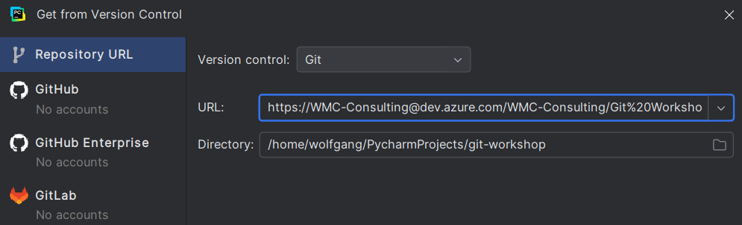
Clone a Remote Repository
Git Integration in PyCharm
From File | New | Project from Version Control you can clone an existing repository
Notes:
https://WMC-Consulting@dev.azure.com/WMC-Consulting/Git%20Workshop/_git/git-workshop

Slide 53
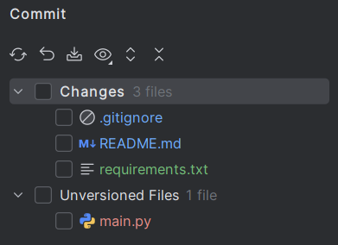
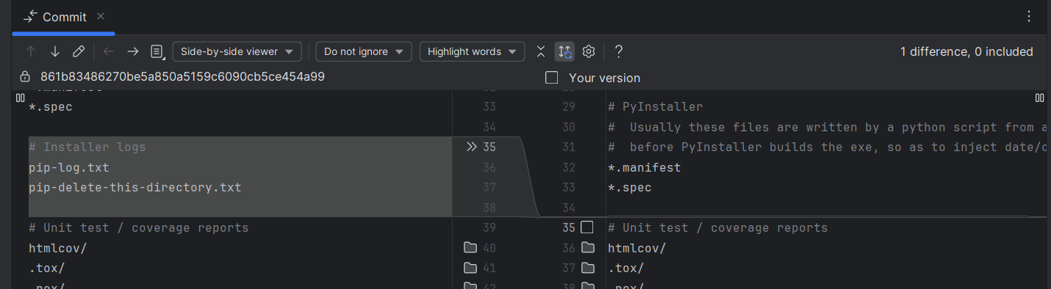
Add Files to Git and Track Changes﻿
Git Integration in PyCharm
In the Commit tool window you can see the Unversioned Files in red
You can also see changes in already tracked files:
Blue: Modified files
Green: New files (added, but not commited)
Double clicking a file shows the diff

Slide 54
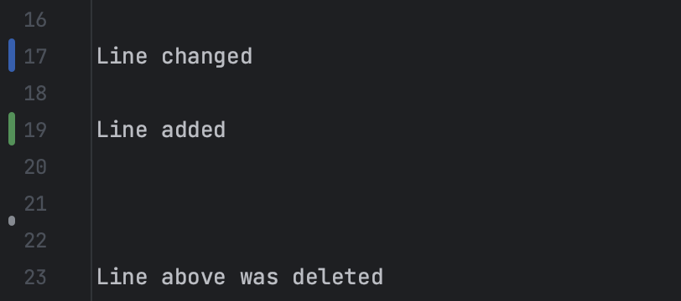
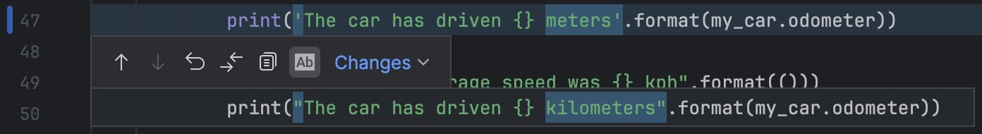
Track Changes to a File in the Editor﻿
Git Integration in PyCharm
Modifications can also be seen in the editor
Changes are highlighted with change markers
Clicking the change marker opens a toolbar
Also, the previous contents are shown
You can rollback this single change by clicking the U-turn arrow

Slide 55
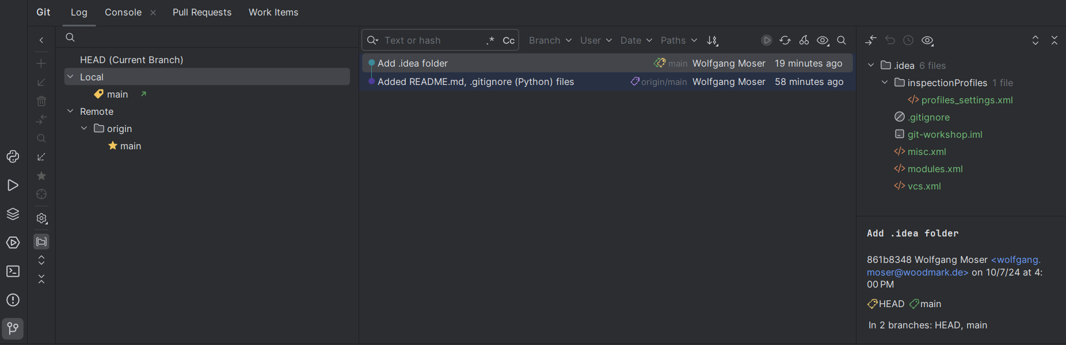
Investigate Changes in Git Repository﻿
Git Integration in PyCharm
To view project history, open the Log tab of the Git tool window
Shows local/remote branches, commits, and changes

Slide 56
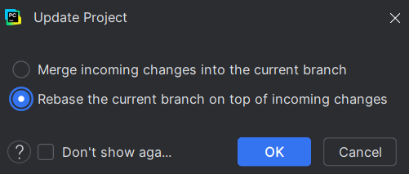
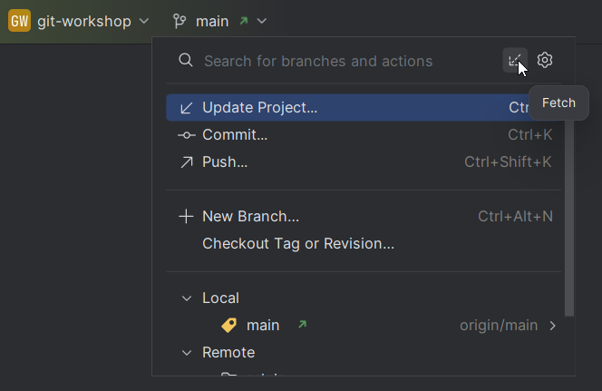
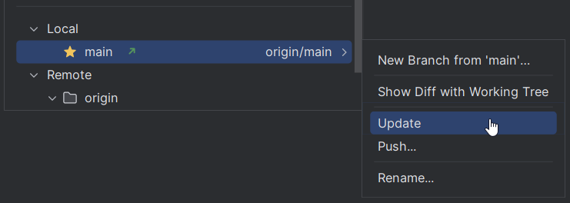
Sync With the Remote Git Repository
Git Integration in PyCharm
To get changes from upstream there are three methods:
Fetch changes and merge them
Pull changes (Update)
Update project (with merge or rebase)

Slide 57
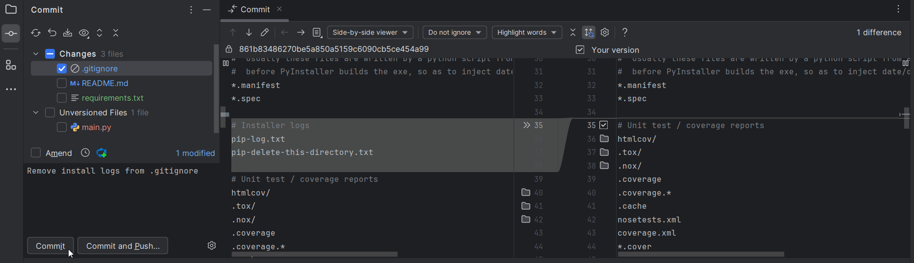
Commit Changes
Git Integration in PyCharm
Make sure Git has your name and email configured: $ git config --global user.name "Wolfgang Moser“ $ git config --global user.email wolfgang.moser@woodmark.de
Select the files that you want to commit in the Commit tool window
Enter the commit message below and press Commit

Slide 58
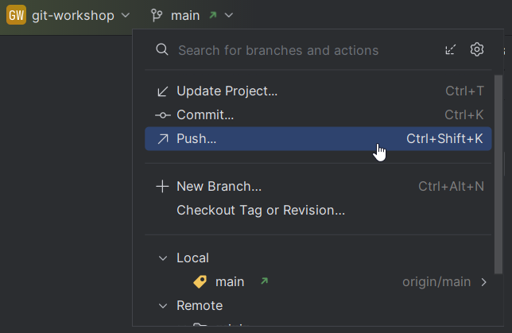
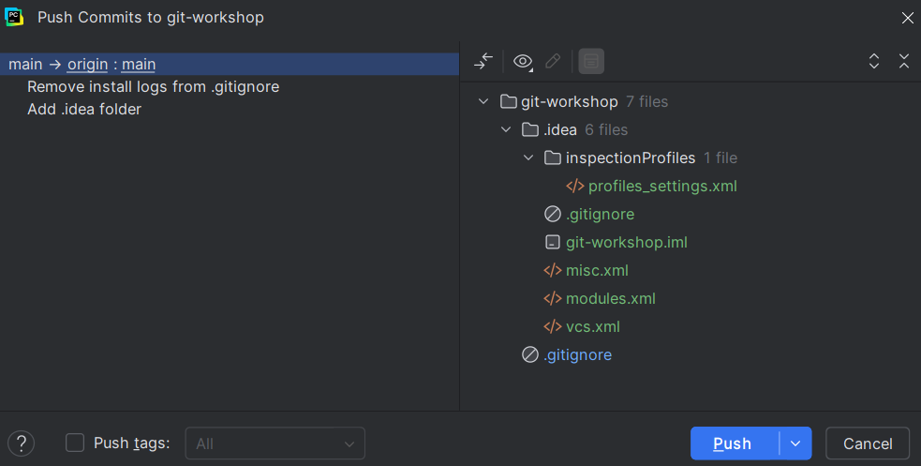
Push Changes
Git Integration in PyCharm
To push changes, click on the branch at the top and choose Push
Review the list of commits since last push
Press Push when ready to publish

Slide 59
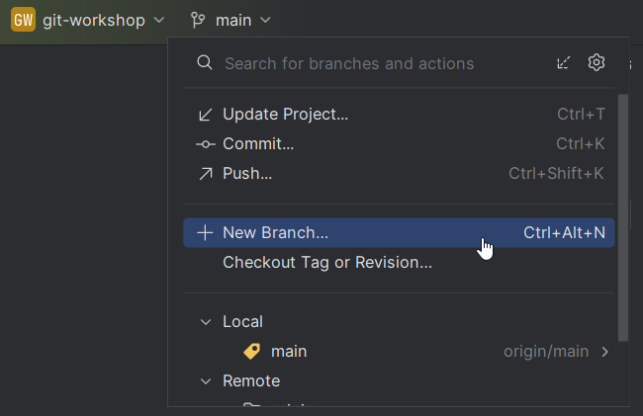
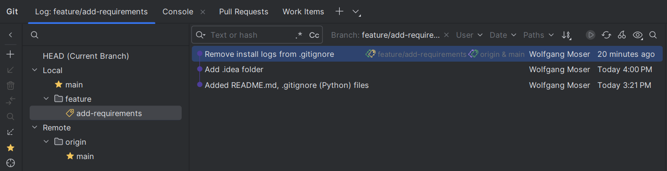
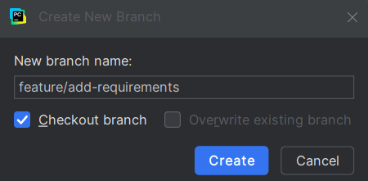
Create Branch
Git Integration in PyCharm
In the Branches popup, choose New Branch
Use Checkout Branch to immediately switch to the branch after creation
You can group branches (by prefix), compare branches, checkout remote branches locally (after fetch), and delete branches

Slide 60
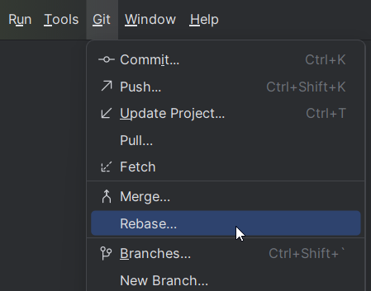
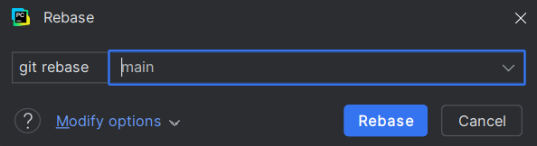
Rebase Branches
Git Integration in PyCharm
From the main menu select Git | Rebase
Choose the target branch onto which you want to rebase the current branch
E.g. the main branch if it contains newer commits that you want to integrate in your feature branch
Click Rebase
If the Rebase was straightforward, you now need to force-push (with lease)
If commits on both branches changed the same contents, you need to resolve the conflicts

Slide 61
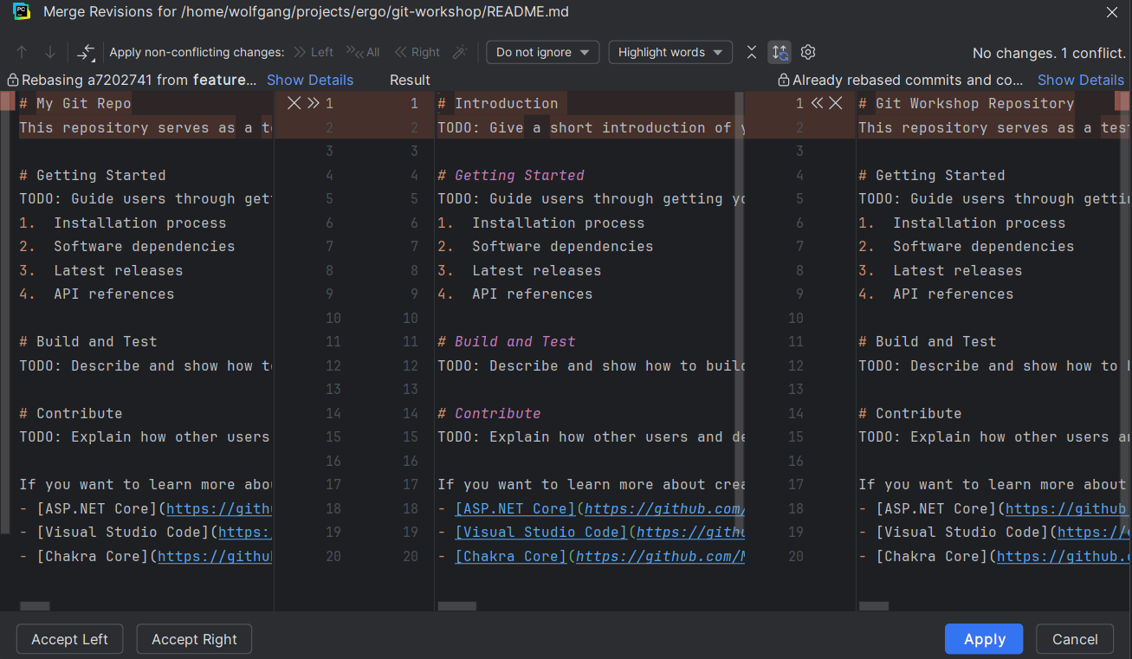
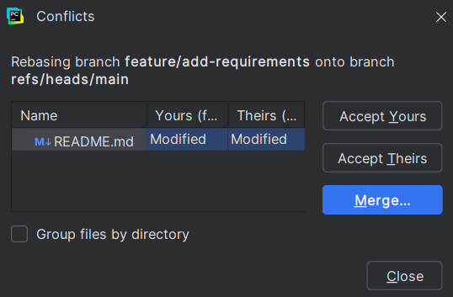
Resolve Conflicts
Git Integration in PyCharm
You can choose to
Accept Yours
Accept Theirs
Merge

Slide 62
Lab #4
Git Integration in PyCharm
Clone the Repository
Clone the repo at: https://WMC-Consulting@dev.azure.com/WMC-Consulting/Git%20Workshop/_git/git-workshop
Explore the Repo
View the Git history and current branches using PyCharm's Git tool window.
Create a Feature Branch
Create a new feature branch in PyCharm.
Modify a file, then commit the changes.
Switch Back to Main
Checkout the main branch.
Make another commit that modifies the same part of the file.
Rebase the Feature Branch
Switch back to the feature branch.
Rebase the feature branch onto main.
Resolve the resulting conflict by choosing the Merge option in PyCharm.

Slide 63
Azure DevOps

Slide 64

What is Azure DevOps?
Azure DevOps
Suite of development tools and services to support the entire software development lifecycle:
Version Control: Manage code with Git repositories.
Collaborative Workflows: Enable seamless collaboration with pull requests and code reviews.
Work Item Tracking: Organize and manage work across teams.
CI/CD Pipelines: Automate builds, tests, and deployments.
Test Plans: Define, manage, and automate test cases for quality assurance.
Artifacts: Package, store, and manage project dependencies.
Notes:
Focus will be on the first two. Short intro also to second two. Last two are not covered.

Slide 65
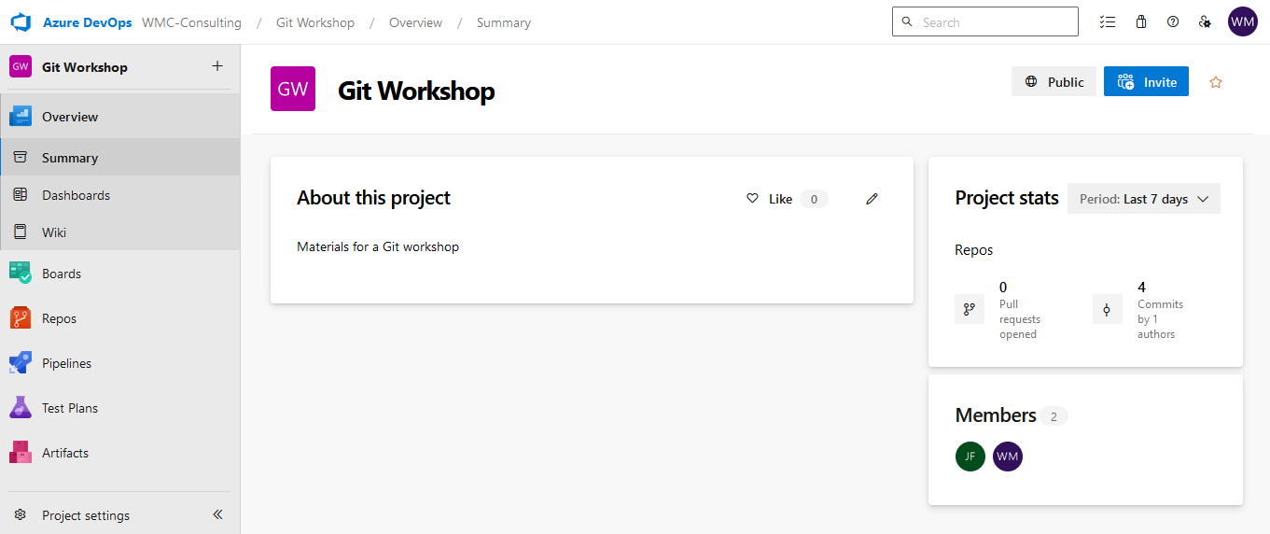
User Interface Overview
Azure DevOps
User Settings
Organization
Project
Work Items
Project Repositories
Project Members
CI/CD Pipelines
Project Settings

Slide 66

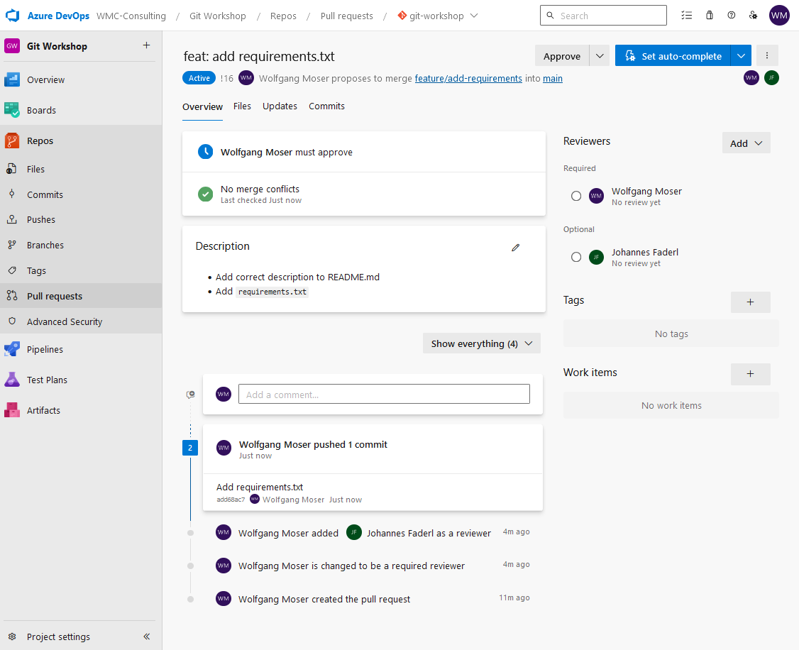
Repositories & Collaboration
Azure DevOps
Files, Commits, Pushes, Branches, Tags: Navigate repository content and track changes.
Pull Requests: Review code changes before merging.
Description Section: Summarize changes for context.
Activity Log: Track commits, comments, and actions.
Reviewers: Assign mandatory and optional reviewers.
Approve & Auto-Complete: Reviewers can approve, reject and set auto-complete options.

Slide 67
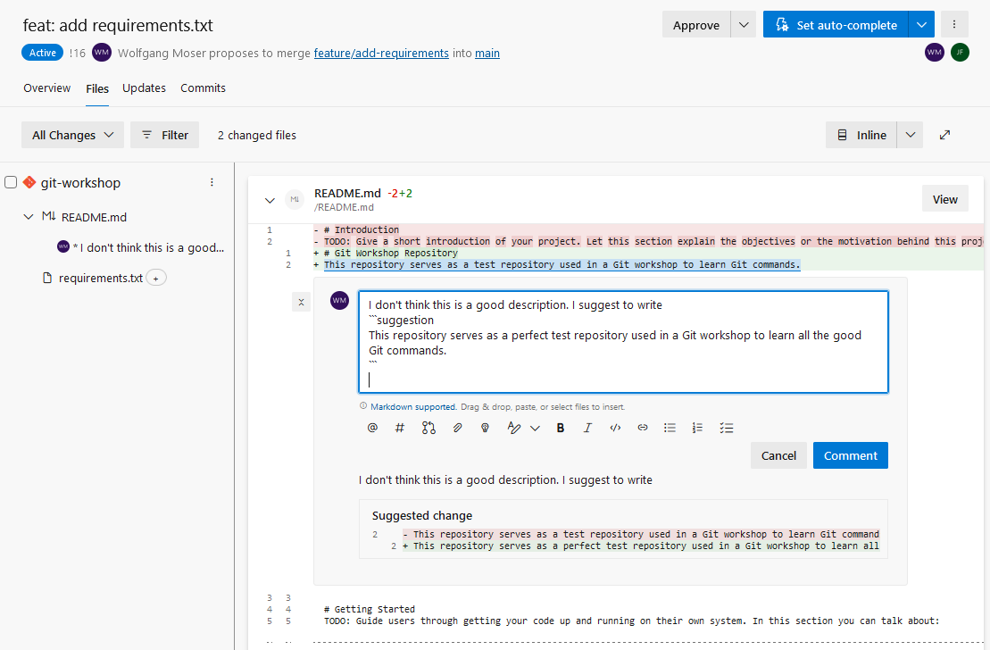
Pull Request Review
Azure DevOps
Overview of Changes: Review all modifications made in the PR, including added or altered files.
Commenting: Leave feedback directly on specific lines to suggest improvements.
Suggestions: Propose changes that can be incorporated by the author for clarity and enhancement.

Slide 68
Code Review Best Practices
Azure DevOps
Respect People’s Time Review PRs promptly, ideally within two hours, to minimize context-switching and wasted effort.
Always Provide Constructive Feedback ❌ Commenting "This is wrong" without offering any alternatives. ✅ Saying "You could improve this by..." to guide the developer positively.
Keep Your Ego Out of Code Reviews ❌ Dismissing a junior developer’s suggestion simply because of their experience level. ✅ Supporting your opinion with links to documentation and inviting discussion on differing views.
Be Precise About What Needs to Be Improved ❌ Commenting vaguely, "Fix this part," without clarity on which function is being referenced. ✅ Stating, "Line 45 needs a clearer variable name; consider renaming foo to userCount.“
Reinforce Code Submission Best Practices Encourage practices like automated testing and using PR templates to streamline the process.
Check the Project’s Satellite Files Review documentation, tests, and configuration files to ensure they align with code changes.

Slide 69
Code Review Best Practices
Azure DevOps
Visualize the Bigger Picture Consider how the changes fit into the overall architecture and future maintainability of the project.
Keep Pull Requests Small Smaller PRs are easier to review and less likely to introduce large bugs.
Make Code Review a Priority Treat code reviews as an essential step in the development process for improving code quality.
Plan for Code Review Time Ensure that time for code reviews is included in your sprint or project planning to avoid delays.

Slide 70
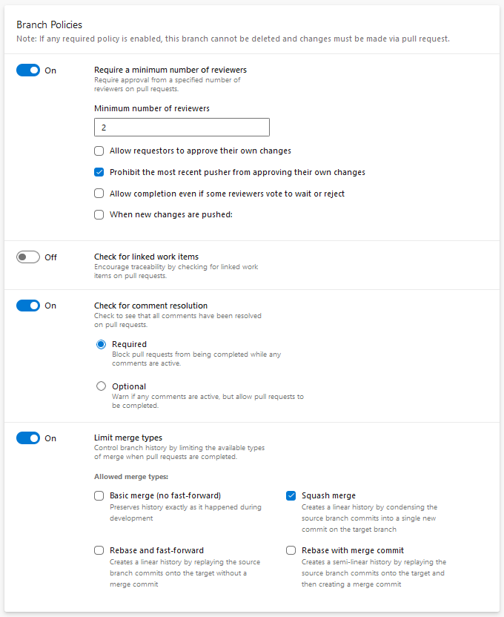
Gobal Repository Settings
Azure DevOps
Branch Policies
Branch cannot be deleted, and changes must be made via pull request
Require a minimum number of reviewers
Check for linked work items
Check for comment resolution
Limit merge types
And in addition
Build Validation
Status Checks
Automatically included reviewers
Notes:
Status Checks: Require other services to post successful status to complete pull requests.

Slide 71
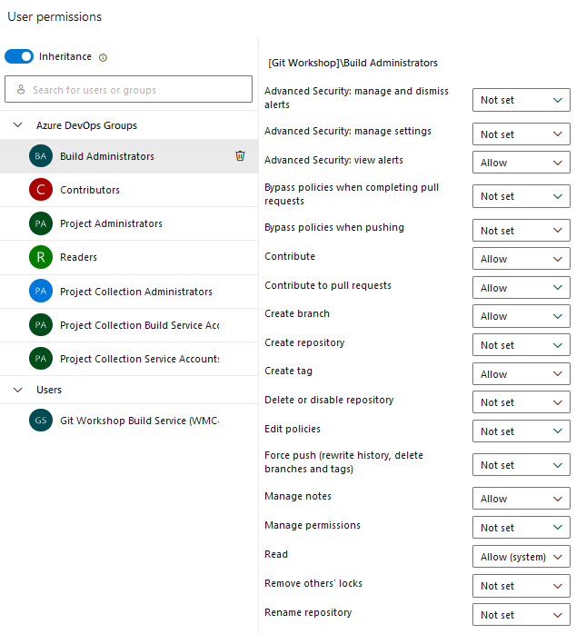
Gobal Repository Settings
Azure DevOps
Security
Specify granular permissions per group or user
Predefined groups such as Contributors or Readers
Permissions are propagated to all repos but can be individually overwritten
Permissions allow to block things like
Repository creation
Repository deletion
Force push
Bypassing policies

Slide 72

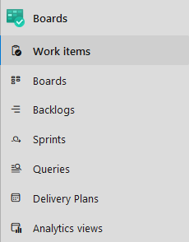
Work Item Tracking
Azure DevOps
Centralized Task Management Track all work items (tasks, bugs, user stories, epics) in one place to ensure alignment and visibility across teams.
Connect Work to Code Link work items directly to code changes, pull requests, and builds for complete traceability throughout the development lifecycle.
Agile Planning Tools Use agile boards (Kanban, Scrum) for sprint planning, task assignment, and real-time progress tracking.
Customizable Workflows Tailor work item types, states, and processes to fit your team's specific workflows and methodologies.

Slide 73
Agile Project Management: Kanban
Azure DevOps
Visualize Workflow Tasks are represented on a board, moving through stages (e.g., To Do, In Progress, Done).
Continuous Flow No time-boxed sprints—work is delivered continuously as it's completed.
Limit Work in Progress Control the number of tasks in progress to prevent overload and improve efficiency.
Kanban Board
Backlog
Doing
Review
Done
Ticket
Ticket
Ticket
Ticket
Ticket
Ticket
Ticket
Ticket
Ticket
Ticket

Slide 74










Agile Project Management: Scrum
Azure DevOps
Roles: Product Owner, Scrum Master, Development Team work together to deliver increments.
Backlog & Refinement: Product Backlog is prioritized and refined regularly to ensure clarity and readiness.
Sprint Planning: Team plans what work to complete in a time-boxed sprint (usually 2-4 weeks).
Daily Standup: Short, daily meeting to track progress and address blockers.
Scrum
Master
Daily
Scrum
Sprint Review: Review completed work with stakeholders and get feedback at the end of each sprint.
Retrospective: Team reflects on the sprint and identifies areas for improvement.
24 h
Product
Owner
Development
Team
Sprint
2-4 Weeks
Sprint Review
+
Sprint Retro
Backlog
Backlog
Refinement
Sprint
Planning
Finished
Work

Slide 75
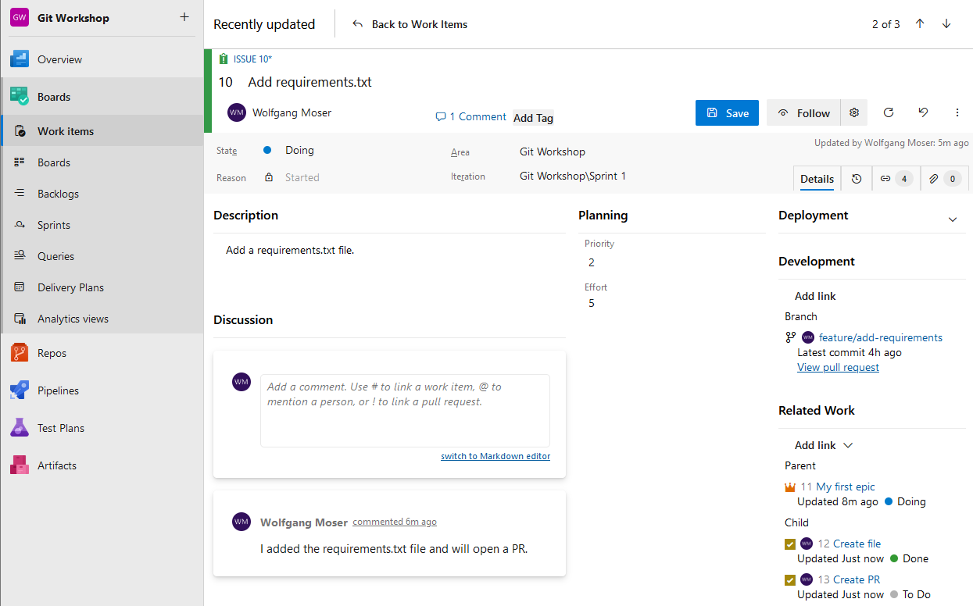
Work Item Tracking
Azure DevOps
Work Items
Assignee
State
Area/Iteration
Description/Discussion
Priority/Effort
Deployment/Development
Related Work: Parent/Child

Slide 76
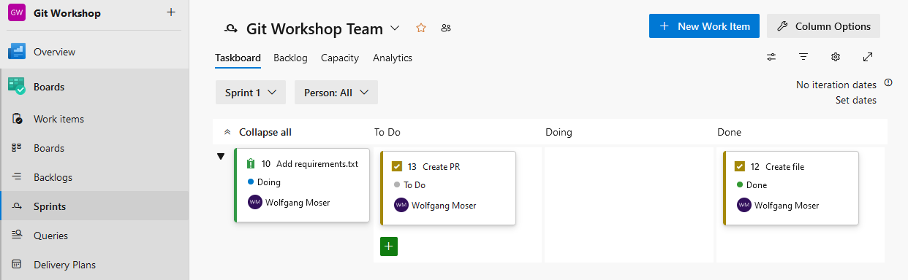
Work Item Tracking
Azure DevOps
Sprints
Show all issues and tasks committed to the sprint
Tasks are put into columns “To Do”, “Doing” and “Done”
Lets you plan team capacity
Also shows analytics (Burndown Trend)

Slide 77
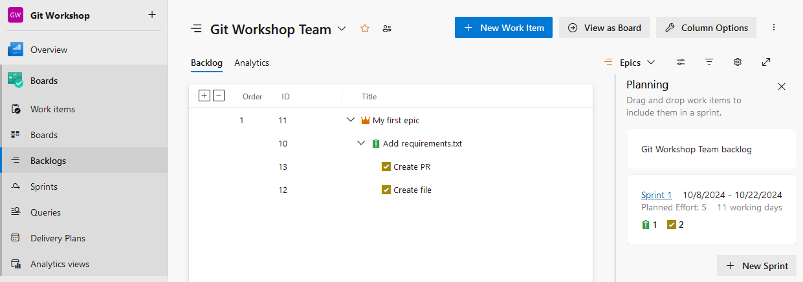
Work Item Tracking
Azure DevOps
Backlogs
Allows for prioritization of epics, issues & tasks
Helps with Sprint planning by offering simple Drag & Drop

Slide 78
Lab #5
Azure DevOps
Azure DevOps
Create an Epic in "Boards" > "Backlogs."
Create an issue, assign it to yourself, and add it to the current sprint.
Create a task under the issue and assign it to yourself.
Set the task state to "Doing."
Create a branch from the task.
Checkout the branch and add a commit.
Create a pull request (PR) for the branch.
Have someone approve the PR.
Merge the PR.
Close the task and the issue.

Slide 79
Lab #5 (alternative)
Azure DevOps
GitHub
Create an issue and assign it to yourself.
Create a branch from the issue.
Clone the repo at https://github.itergo.com/E656422/git-workshop
Checkout the branch and add a commit.
Create a pull request (PR) for the branch.
Have someone approve the PR.
Merge the PR.
Close the task and the issue.

Slide 80

CI/CD Pipelines
Azure DevOps
Automated CI/CD Build, test, and deploy code automatically with continuous integration and continuous delivery pipelines.
Multi-platform Support Run pipelines for any language or platform (Windows, Linux, macOS) with flexible environments.
Customizable Workflows Define tailored workflows using YAML or the visual editor to fit your project's needs.
Parallel & Fast Builds Speed up builds with parallel job execution and distributed agents.

Slide 81
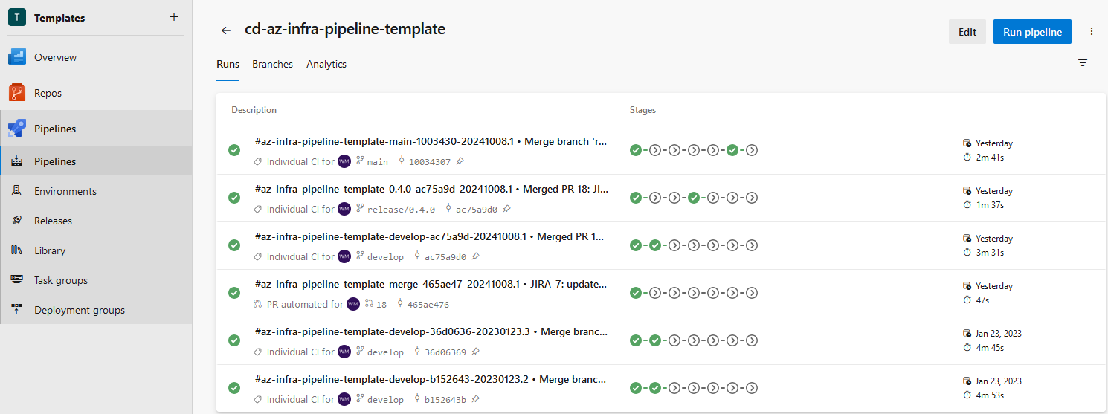
CI/CD Pipelines
Azure DevOps
YAML Pipelines Features
Pipeline Run
Classic Pipelines Features

Slide 82
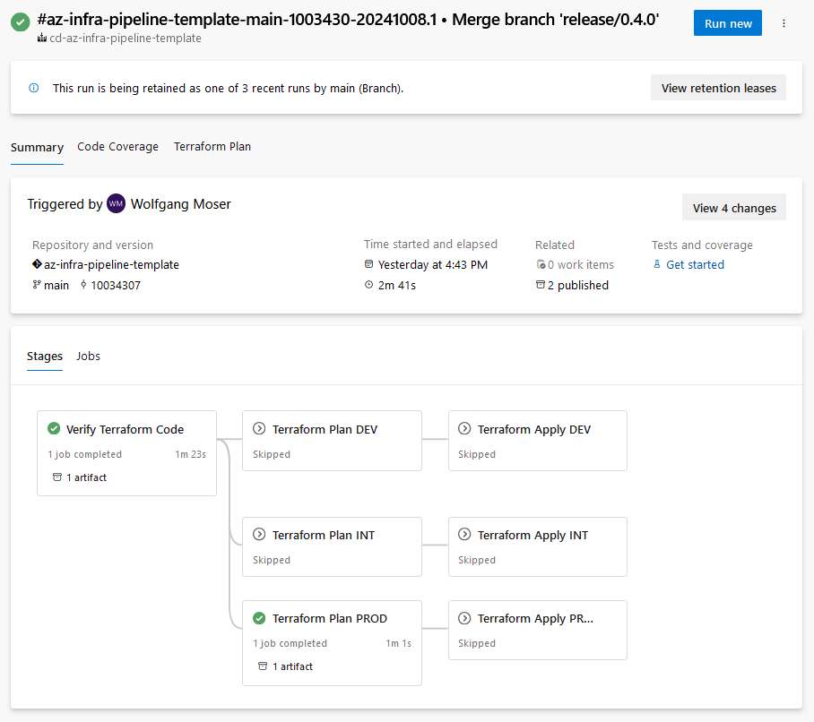
CI/CD Pipelines
Azure DevOps
Pipeline Run
Shows repository, branch, and commit
Also displays run date and duration
Pipelines can publish artifacts
Triggers start pipelines
Pipelines are split into stages
Stages have jobs and jobs have steps
Stages and jobs can depend on other stages and jobs
Each job runs on one agent

Slide 83




CI/CD Pipelines
Azure DevOps
Key Concepts
Pipeline
Stage
Steps
Trigger
Stage
Agent
Step: Script
Stage
Job
Step: Task
Publish build artifact
Stage
Job
Step: Task
Azure App Service deploy
Depends
on
Steps
Agent
Job
Step: Task
Invoke REST API

Slide 84
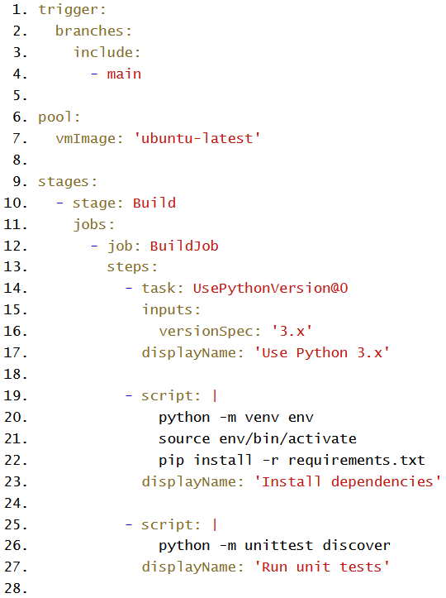
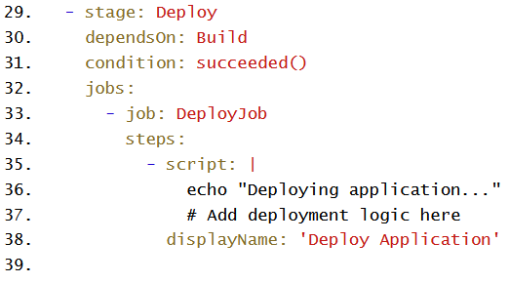
CI/CD Pipelines
Azure DevOps
Trigger on main commit
YAML Pipeline Example
Trigger on main commit
Run on Ubuntu agent
Build stage
Install Python
Create Venv and install dependencies
Run unit tests
Deploy stage
Only runs if build succeeded
Deploy application
Prepared Task
Conditional Execution
Notes:
Screenshots created with https://highlight.hohli.com/?language=yaml&theme=xcode&numbers=1

Slide 85
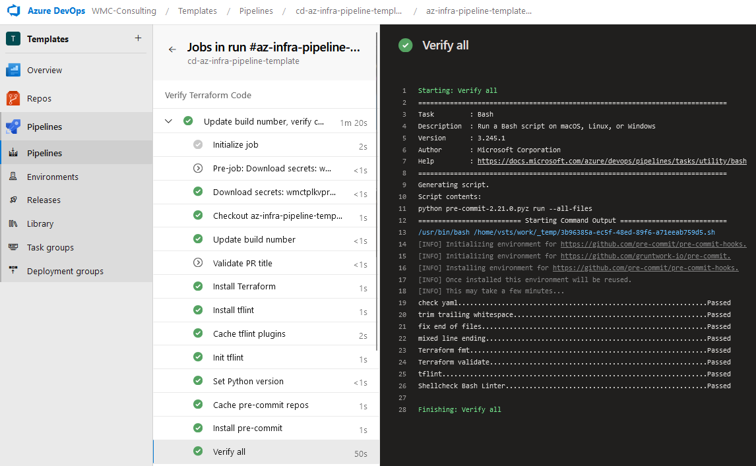
CI/CD Pipelines
Azure DevOps

Slide 86
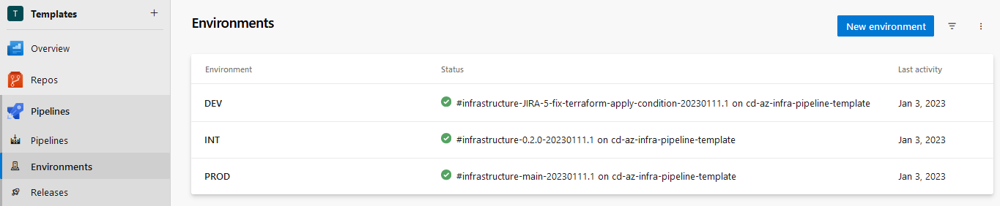
CI/CD Pipelines
Azure DevOps
Environments
Used for deployments to different stages
Can be targeted in jobs (deployment jobs)
Gives an overview of what is deployed where

Slide 87
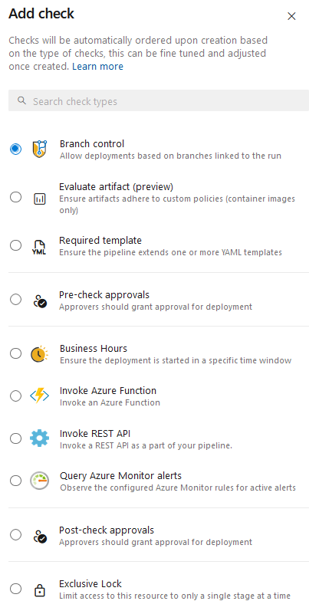
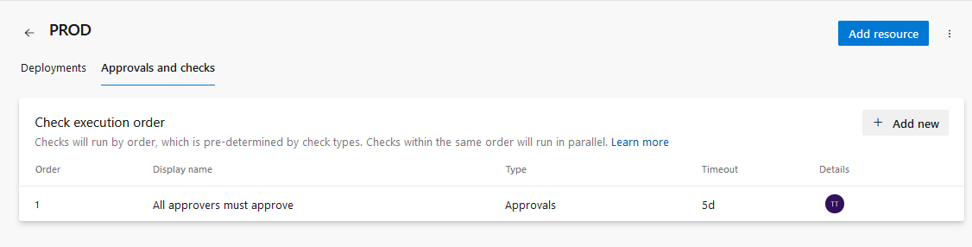
CI/CD Pipelines
Azure DevOps
Environments
Environments also support Approvals & Checks
Deployment Approvals
Branch Checks
Time Constraint Checks
Invoke Azure Function

Slide 88
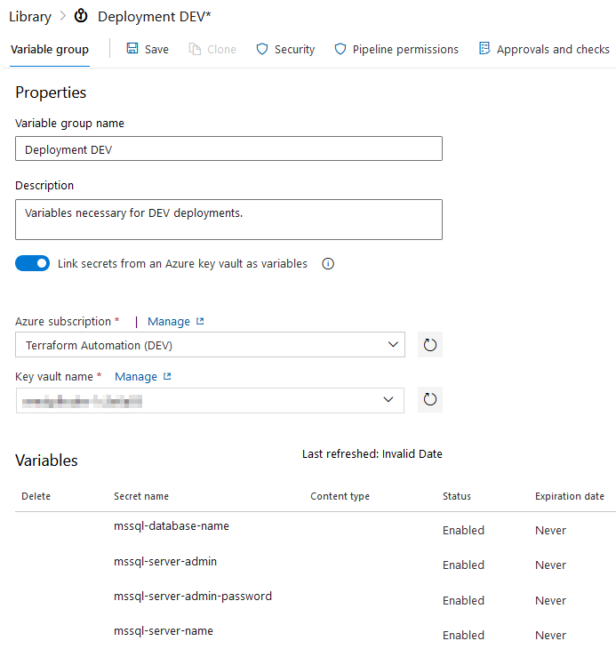
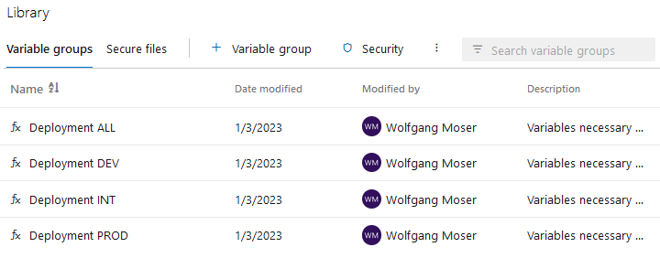
CI/CD Pipelines
Azure DevOps
Library
Stores Variable Groups and Secure Files
Can be accessed in pipelines to retrieve secrets & variables
Secrets can also be linked from Azure Key Vault

Slide 89
Comparison: Azure DevOps & GitHub
Azure DevOps
Azure DevOps
Pros:
🟩 Comprehensive toolset (Repos, Pipelines, Boards, Test Plans, Artifacts)
🟩 Strong integration with Azure services and enterprise workflows
Cons:
🟥 Rather closed ecosystem
🟥 Smaller community
🟥 Fewer features
GitHub
Pros:
🟩 More user-friendly for open-source and smaller teams
🟩 Massive community with extensive third-party integrations
Cons:
🟥 Limited built-in project management features
🟥 Enterprise-level features require higher-cost plans
Both platforms are owned by Microsoft and therefore have a lot in common!

Slide 90
Thank you for your attention!

